Slide 1
Part.1
荷兰国家的形成与发展

Slide 2
Part.1: How the Netherlands became the Netherlands it is today
促使那些如今被称为低地国家的地区统一的是勃艮第家族，这个家族本是法兰西王室瓦卢瓦家族（House of Valois）的支系。勃艮第公国［以第戎（Dijon）为首府］是法兰西国王的封地。法兰西国王约翰二世（Jean Ⅱ）在1363年将公国分封给儿子大胆者腓力（Philip the Bold），作为其收入来源。腓力（大胆者）与佛兰德-阿图瓦（Artois）伯爵富有的女继承人结婚，从而将这些北部富裕的伯国收入囊中。这场联姻还意味着腓力（大胆者）获得了勃艮第公国东边的勃艮第自由伯国，即弗朗什-孔泰（Franché-Comté），巩固了他在南方的地位。

Slide 3
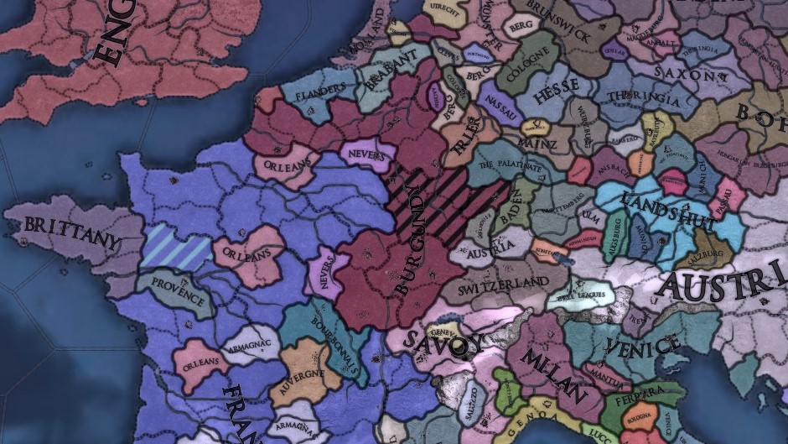
Part.1: How the Netherlands became the Netherlands it is today

Slide 4
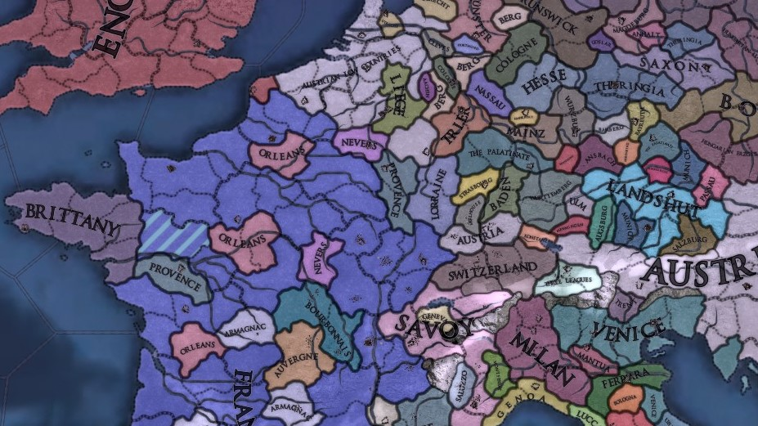
Part.1: How the Netherlands became the Netherlands it is today
1477.1.5

Slide 5
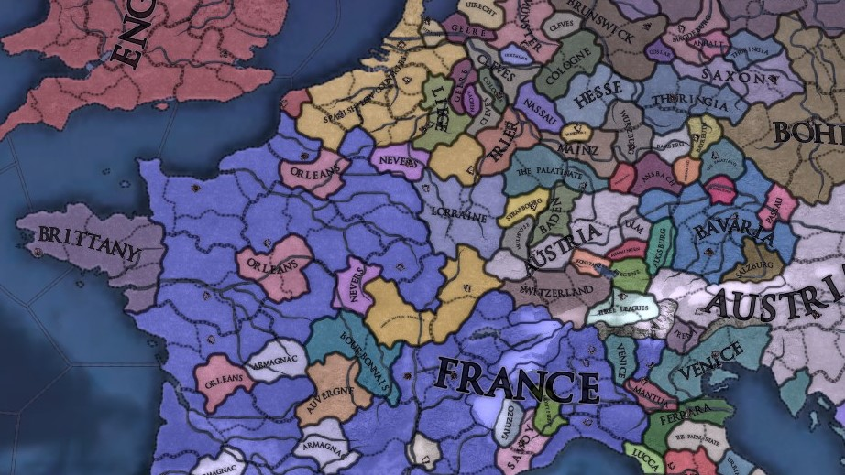
Part.1: How the Netherlands became the Netherlands it is today
1519.1.12

Slide 6
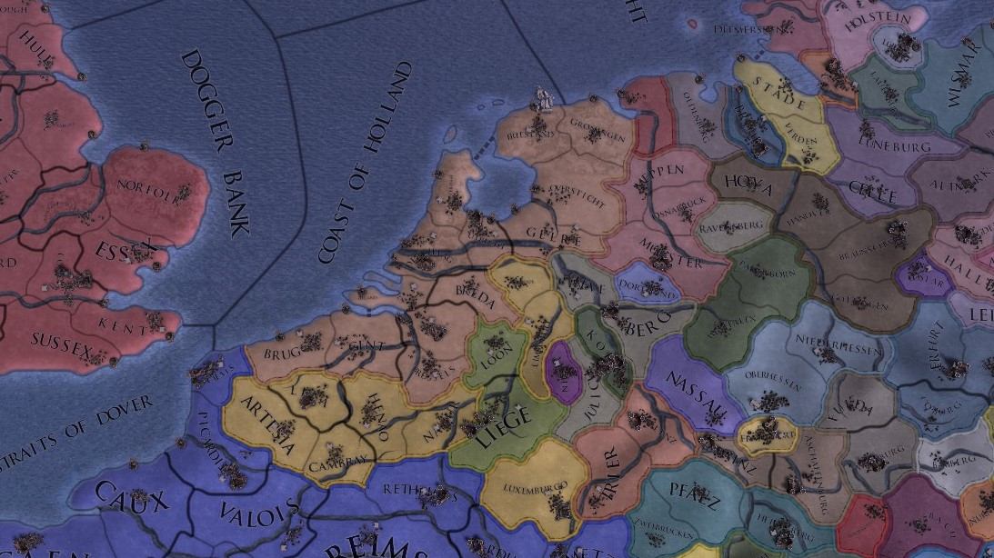
Part.1: How the Netherlands became the Netherlands it is today
1579.1.23

Slide 7
Part.1: How the Netherlands became the Netherlands it is today
“The members of the House of Orange-Nassau have created and shaped Holland. Every stadtholder, king and queen worked to better Holland in their own way, for instance by defending freedom and independence, stimulating art and culture, or improving social coherence. The rich history of the House of Orange-Nassau has left its mark on various places in Holland: palaces, mausoleums, historic places and monuments tell the stories of royal Holland.”
-www.holland.com

Slide 8
Part.1: How the Netherlands became the Netherlands it is today
“In 1572, William of Orange moves into the Prinsenhof in Delft, where it remains fairly quiet and peaceful during the revolt. He leads the revolt against the Spanish from Delft. And successfully so! In 1579, the Union of Utrecht is arranged and signed by William of Orange, laying the basis for the nation we are today. At that time however, Holland was not yet a kingdom.”
-www.holland.com

Slide 9
Part.1: How the Netherlands became the Netherlands it is today
The Pacification of Ghent, signed on 8 November 1576, was an alliance between the provinces of the Habsburg Netherlands. The main objectives were to remove Spanish mercenaries who had made themselves hated by all sides due to their plundering, and to promote a formal peace with the rebellious provinces of Holland and Zeeland.
根据双方达成的协议，南北代表签署了《根特和解协定》，确定了尼德兰统一的原则。双方还一致同意，要废除阿尔瓦公爵统治尼德兰时颁布的一切法律，坚决与西班牙军队战斗到底。

Slide 10
Part.1: How the Netherlands became the Netherlands it is today
1568年，荷兰因反抗西班牙国王的中央集权和对新教加尔文派的迫害，爆发了北方省反抗西班牙的八十年战争，1579年荷兰北方省中的七省（现在荷兰、比利时和卢森堡的区域）成立了乌得勒支同盟。西班牙最初成功地镇压叛乱。但荷兰的起义军屡败屡起。这时尚未独立的荷兰北部在经济，科学和文化的发展已有相当的成就。乌得勒支联盟虽然始终无法击败西班牙军队，但却成功削弱了西班牙的战力，使西班牙政府乏于应付内外夹击的战事。
双方在1641年开始在德国境内的明斯特和奥斯纳布吕克展开谈判，边打边谈。1648年西班牙国王费利佩四世签订《明斯特和约》，承认七低地（尼德兰）／七省联合共和国（Republiek der Zeven Verenigde Nederlanden/Provinciën）。获得独立之后，荷兰发展成为17世纪航海和贸易强国。

Slide 11

Part.1: How the Netherlands became the Netherlands it is today
曼哈顿

Slide 12

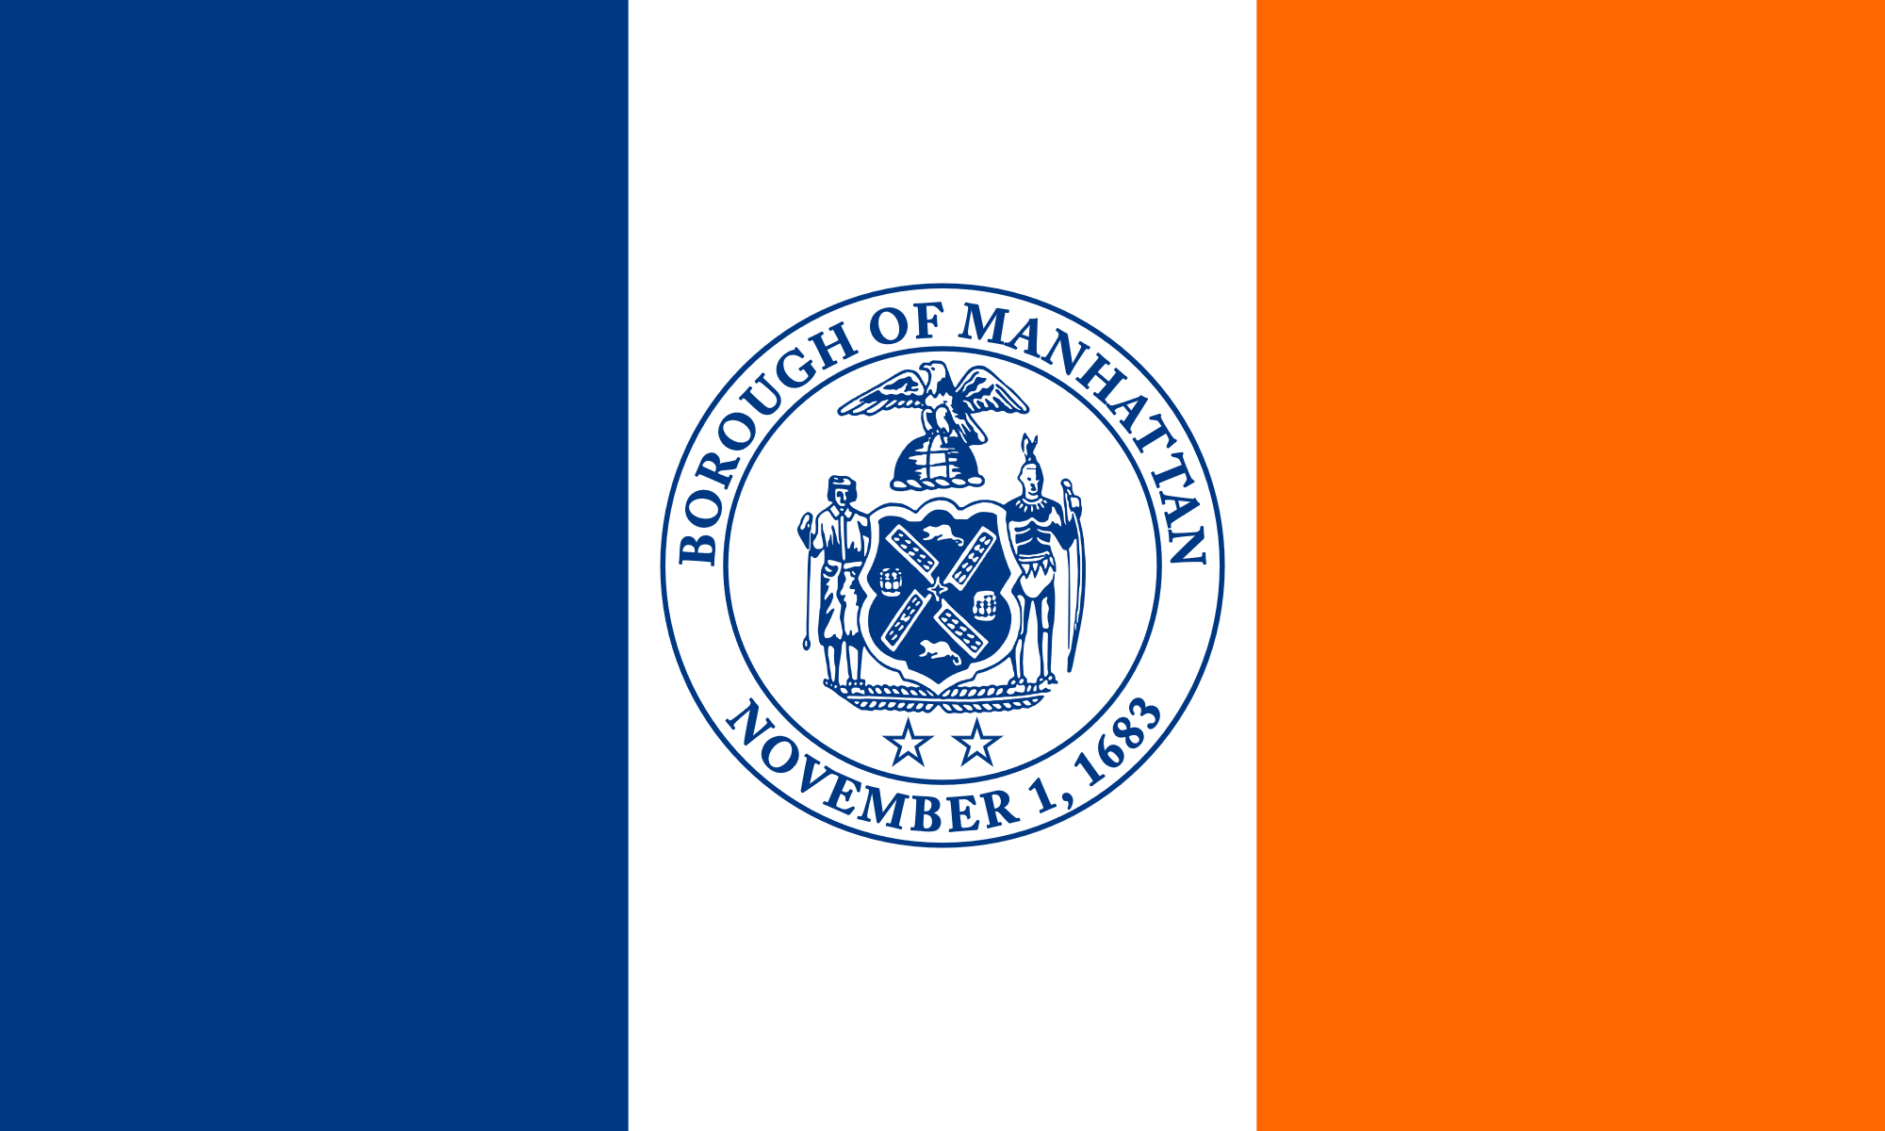
Part.1: How the Netherlands became the Netherlands it is today
亲王旗
曼哈顿旗

Slide 13
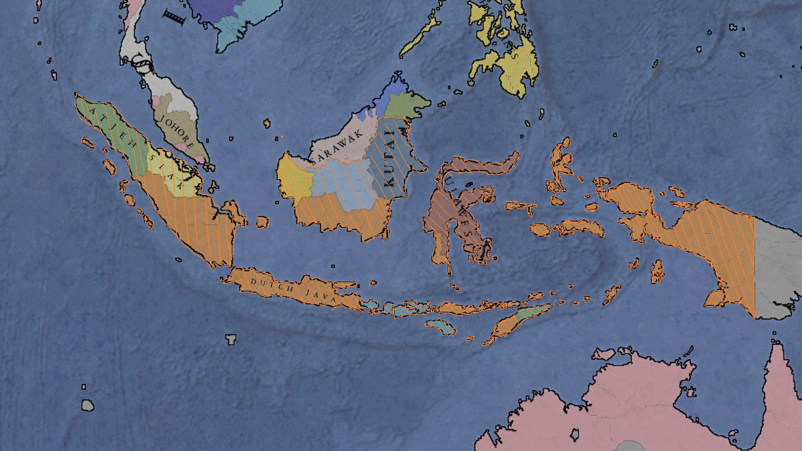
Part.1: How the Netherlands became the Netherlands it is today
印度尼西亚

Slide 14
Part.1: How the Netherlands became the Netherlands it is today
荷兰怎么从联省共和国变成荷兰王国的？

Slide 15
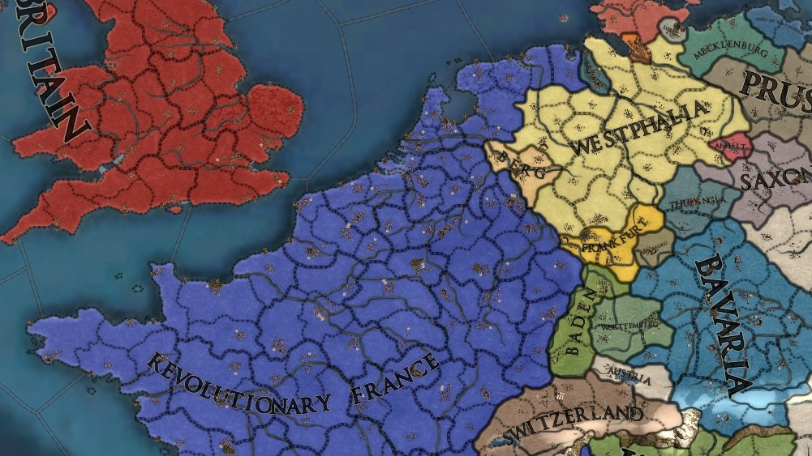
Part.1: How the Netherlands became the Netherlands it is today
1810

Slide 16
Part.1: How the Netherlands became the Netherlands it is today
维也纳条约：
低地部分
荷兰王国：和南尼德兰（约今比利时）合并为一个君主立宪制国家荷兰联合王国。
卢森堡：因为奥兰治-拿骚的拿骚领地已归普鲁士，作为补偿，荷兰联合王国和卢森堡大公国将在奥兰治-拿骚王朝之下建立共主邦联，卢森堡加入德意志邦联。

Slide 17
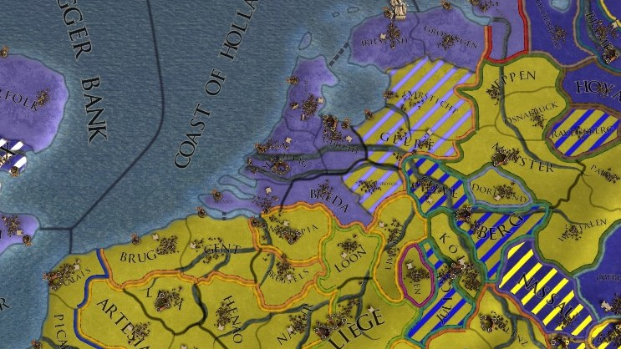
Part.1: How the Netherlands became the Netherlands it is today
黄：天主教区域 浅蓝：新教（加尔文宗）区域

Slide 18
Part.1: How the Netherlands became the Netherlands it is today
1830年，比利时人受到法国七月革命的鼓励，反抗在1815年维也纳会议上强行合并荷兰及比利时两国的决定，为争取比利时独立及成立自由主义政府而发生了革命，1831年为了解决比利时问题，在伦敦开始谈判，比利时议会很快批准了条约，然而，荷兰国王威廉一世态度顽固，不承认比利时的独立，拒绝在条约签字，并在1831年8月2日打破了休战协定，试图恢复对比利时的统治，在法国的干预下，10天后双方再次停火。1833年5月21日，双方同意无限期停战，尊重现状和保证河流的通航自由。1838年至1839的伦敦会议后，在欧洲列强的外交压力下，才在条约上正式签字，《伦敦条约》才正式生效。

Slide 19
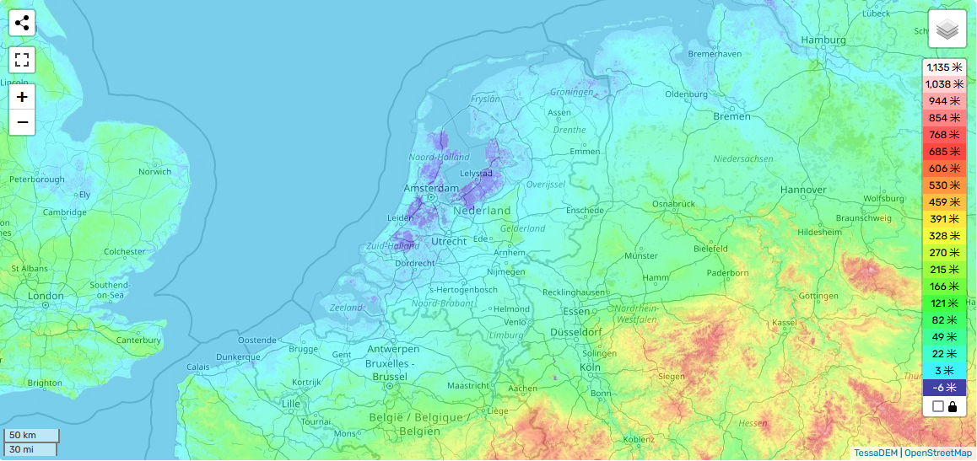
Part.1: Netherlands economic development
荷兰地势

Slide 20
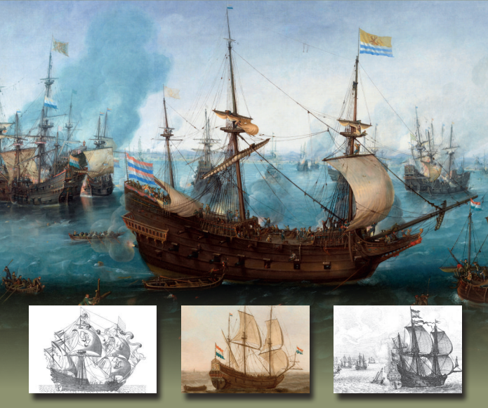
Part.1: Netherlands economic development

Slide 21
Part.1: Netherlands economic development
Under William the Silent, the Dutch navy secured the Republic’s home waters. Under Maurice it brought the war to the enemy and went out to put the Republic’s stamp on the world. Under Frederick Henry it consolidated the Republic’s new-found position. Over these 80 years the big, strong but slow merged with the small, fast but weak into efficient navy ships, good at both sailing and fighting. Not long after the war the navy finally turned into a standardized, state-owned military fleet. The introduction of the drake around 1620 resulted in considerable cost and weight savings, while increasing the weight of a ship’s broadside. Naval line-of-battle tactics matured during this period.

Slide 22
Part.1: Netherlands economic development
Tulpenmanie
在约1634年左右，郁金香的大受欢迎引起了投机分子的目光，他们对于栽培郁金香或是赏花并没有兴趣，只是为了哄抬价格取得利润。此时郁金香受欢迎的风气从莱顿传到阿姆斯特丹、哈勒姆等城市，需求量日渐扩大。这些投机分子有计划地行动，有人因此一掷千金，当时甚至还有过一个高级品种的球根交换了一座宅邸的纪录。
郁金香泡沫经济的瓦解，对于经济和之后的荷兰历史如同蜻蜓点水一般，几乎没有留下任何的影响。虽然植物爱好者继续追求高价的郁金香，但是在史料上并没看到对于其他产业的打击，有较大影响的是在精神文化的层面。
经济发展较好

Slide 23
Part.1: Netherlands economic development
But…
The republic did not form a formal military alliance with France and her allies before the end of the war. A treaty of amity and commerce was, however, concluded with the Americans in October 1782, after John Adams, who succeeded Henry Laurens, had managed to obtain diplomatic recognition of the American republic from the States General in April 1782. The republic was the second European power (after France, but before Spain) to recognise the United States. Adams also succeeded in raising a substantial loan for the Americans on the still-significant Dutch capital market.
The republic involved itself in the peace congress that the French foreign minister, Vergennes, organised, negotiating separately with the British commissioners. The Dutch demands were not supported by the French, and this put them into an untenable position when the French and their allies went ahead with the signing of the general peace. The Dutch, therefore, were forced to sign a preliminary peace just before that general treaty was signed. The republic joined the armistice between Britain and France in January 1783. The signing of the Treaty of Paris (1783–1784) made Negapatnam, in India, a British colony. Ceylon was restored to Dutch control. The British gained the right of free trade with part of the Dutch East Indies, which had been a major war aim for British merchants. The French also returned the other Dutch colonies they had recaptured from the British, including the ones in the West Indies (like St. Eustatius that had been taken by Admiral Rodney in February 1781, but was retaken by the French Admiral De Grasse on 27 November 1781).

Slide 24
Part.1: Netherlands economic development
体量较“小”

Slide 25
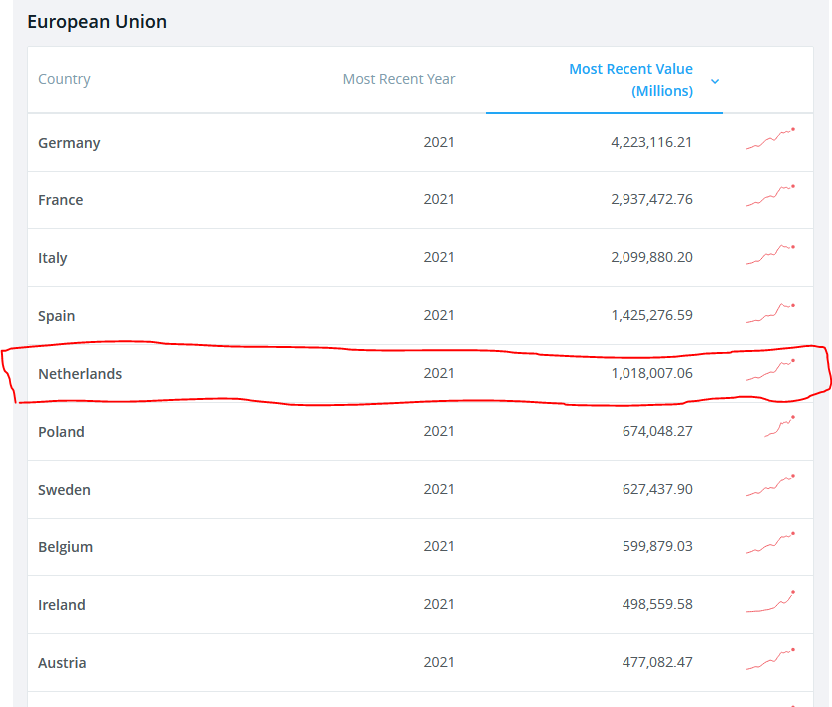
Part.1: Netherlands economic development
~5%欧盟GDP

Slide 26
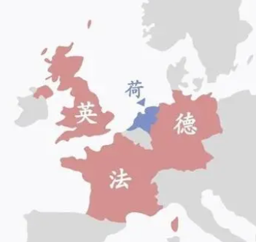
Part.1: Netherlands economic development

Slide 27
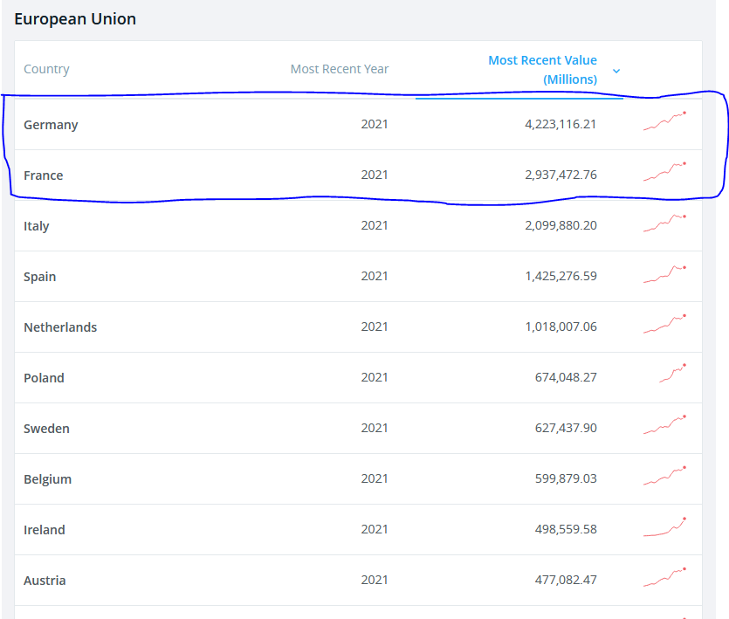
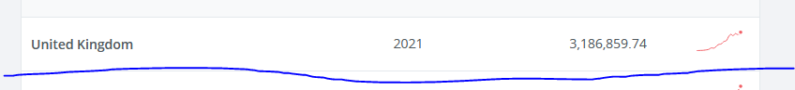
Part.1: Netherlands economic development

Slide 28
Part.1: Netherlands economic development
这样会带来什么影响？
难以形成规模效应
抗风险能力较差
->依赖全球化

Slide 29
Part.1: Conclusion
故荷兰：
经济发展较好 但体量较小 难以成为独立的一股力量
政治上较依赖欧盟

